Slide 1
Exploring venues in Pune, India
using Foursquare and Zomato API
- Pratik. Pore

Slide 2
Introduction
Aim
Context
Problem statement
The aim of the project is to identify venues in Pune, India based on their rating and average prices.
In this notebook, we will identify various venues in the city to help visitors select the restaurants that suit them the best.
Identifying places that are fit for various individuals based on the information collected from the two APIs and Data Science.
Once we have the plot with the venues, any company can launch an application using the same data and suggest users such information.
If a person searches for a venue in a new city, they’re interested in the best places that the city has to offer.
The venues with their price and rating information would help visitors make better decisions about places they should visit.

Slide 3
Challenges deep-dive
Challenge 1
Challenge 2
Challenge 3
Use Foursquare API
Using the Foursquare’s explore API (which gives venues recommendations), I fetched venues up to a range of 10 kilometers radius from the center of Pune and collected their names, categories and locations (latitude and longitude).
Use Zomato API
I used the Zomato search API to fetch venues from its database.
This API allows to find venues based on search criteria (usually the name), latitude and longitude values and more.
Given that the data from the two APIs did not align completely, I had to use data cleaning to combine the two datasets properly.
Clustering
I cluster all the venues based on their price range, location and more to identify similar venues and the relationship amongst them.
I used KMeans clustering and decided to cluster the venues into two separate groups.

Slide 4
Solution
Based on our analysis above, we can draw a number of conclusions that will be useful to aid any visitor visiting the city of Pune, India.
Better Food Assistance for Tourist

Slide 5
Implementation

Slide 6
The first cluster is spread across the whole city and includes the majority venues.
Get location and other information about various venues in Pune.
Use this information to build an online website/mobile app, to provide users about venues in the city based on the search criteria.
10.04.2020
16.04.2020
25.04.2020
26.04.2020
02.05.2020
Venues will be plot using proper color coding such that a simple glance at the map would reveal the location of the venues as well as give information about them.
The second cluster is very sparsely spread and has very limited venues.

Slide 7
Conclusion
max growth

Slide 8
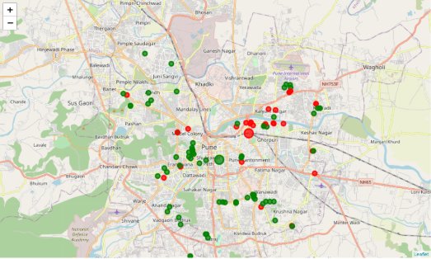
The venues have been identified using Foursquare and Zomato API and have been plotted on the map.
The map reveals that there are three major areas a person can visit: Deccan Gymkhana, Koregaon Park, and Kondhawa.

